Slide 1
BRANCH AND BOUND
SUBMITTED BY:- ABHINAV SINGH
roll no. – 181210001
DIMPAL KATANIYA
roll no. – 181210022
CSE 2ND YEAR

Slide 2
BRANCH AND BOUND ALGORITHM TECHNIUQE:-
BRANCH AND BOUND
Branch and bound is an algorithm design paradigm which is generally used for solving combinatorial optimization problems.
These problems are typically exponential in terms of time complexity and may require exploring all possible permutations in worst case.
The Branch and Bound Algorithm technique solves these problems relatively quickly

Slide 3
BRANCH AND BOUND
The algorithm explores branches of this tree, which represent subsets of the solution set.
Before enumerating the candidate solutions of a branch, the branch is checked against upper and lower estimated bounds on the optimal solution, and is discarded if it cannot produce a better solution than the best one found so far by the algorithm
Example problems:-
- 0/1 knap sack problem
Job assignment problem

Slide 4
1. 0/1 knap sack problem:-
BRANCH AND BOUND – 0/1 knap sack problem
Given two integer arrays val[0..n-1] and wt[0..n-1] that represent values and weights associated with n items respectively.
Find out the maximum value subset of val[] such that sum of the weights of this subset is smaller than or equal to Knapsack capacity W.

Slide 5
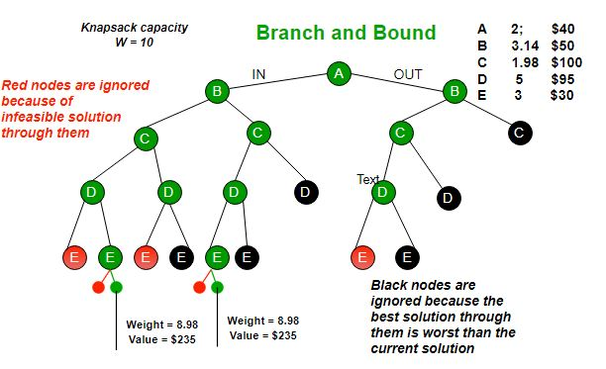
Example problem:-
BRANCH AND BOUND – 0/1 knap sack problem

Slide 6
Algorithm:-
BRANCH AND BOUND – 0/1 knap sack problem
Sort all items in decreasing order of ratio of value per unit weight so that an upper bound can be computed using Greedy Approach.
Initialize maximum profit, maxProfit = 0
Create an empty queue, Q.
Create a dummy node of decision tree and enqueue it to Q. Profit and weight of dummy node are 0.
Do following while Q is not empty.
Extract an item from Q. Let the extracted item be u.
Compute profit of next level node. If the profit is more than maxProfit, then update maxProfit.
Compute bound of next level node. If bound is more than maxProfit, then add next level node to Q.
Consider the case when next level node is not considered as part of solution and add a node to queue with level as next, but weight and profit without considering next level nodes.

Slide 7
JOB ASSIGNMENT PROBLEM:-
BRANCH AND BOUND – JOB ASSIGNMENT PROBLEM
Let there be N workers and N jobs. Any worker can be assigned to perform any job, incurring some cost that may vary depending on the work-job assignment.
It is required to perform all jobs by assigning exactly one worker to each job and exactly one job to each agent in such a way that the total cost of the assignment is minimized.

Slide 8
Solution using backtracking:-
BRANCH AND BOUND – JOB ASSIGNMENT PROBLEM
The selection rule for the next node in BFS and DFS is “blind”. i.e. the selection rule does not give any preference to a node that has a very good chance of getting the search to an answer node quickly.
The search for an optimal solution can often be speeded by using an “intelligent” ranking function, also called an approximate cost function to avoid searching in sub-trees that do not contain an optimal solution. It is similar to BFS-like search but with one major optimization.
Instead of following FIFO order, we choose a live node with least cost. We may not get optimal solution by following node with least promising cost, but it will provide very good chance of getting the search to an answer node quickly.
There are two approaches to calculate the cost function:
For each worker, we choose job with minimum cost from list of unassigned jobs (take minimum entry from each row).
For each job, we choose a worker with lowest cost for that job from list of unassigned workers (take minimum entry from each column).

Slide 9
Algorithm:-
BRANCH AND BOUND – JOB ASSIGNMENT PROBLEM
node
{int job_number;
int worker_number;
node parent;
int cost;}
algorithm findMinCost (costMatrix mat[][])
{ while (true)
{E = Least();
if (E is a leaf node)
{ printSolution();
return; }
for each child x of E
{ Add(x);
x->parent = E; }}}

